Slide 1
Processes

Slide 2
Differentiate
Program
Process
Thread

Slide 3
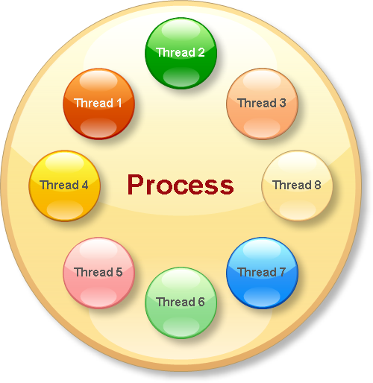
Thread Vs Process

Slide 4

Process Vs Program

Slide 5
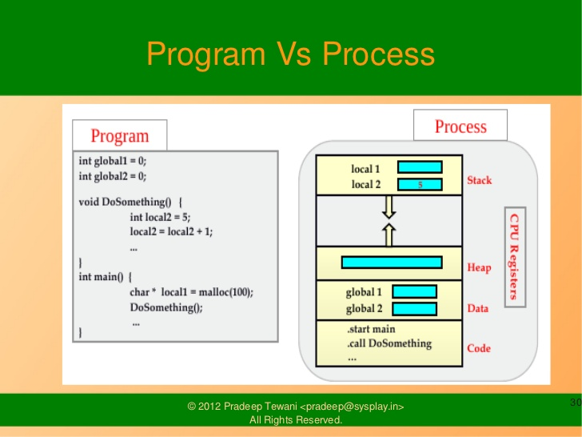

Slide 6
Process Concept
Job and process
Process – a program in execution; process execution must progress in sequential fashion
A process includes:
program counter
stack
data section

Slide 7
Process State
As a process executes, it changes state
new: The process is being created
running: Instructions are being executed
waiting: The process is waiting for some event to occur
ready: The process is waiting to be assigned to a process
terminated: The process has finished execution

Slide 8
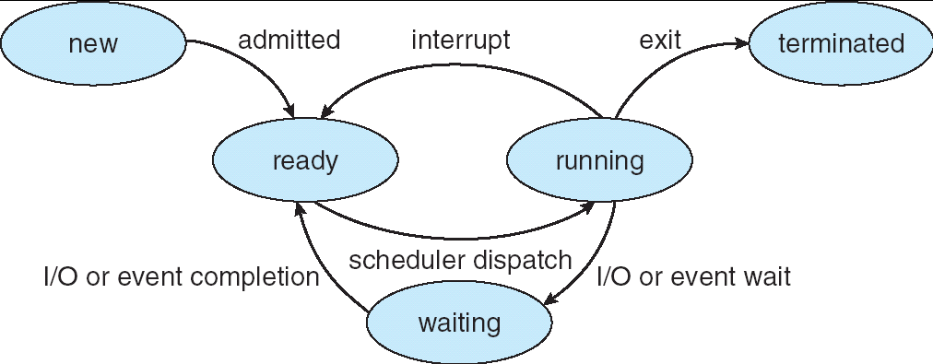
Diagram of Process State

Slide 9
Process Control Block (PCB)
Information associated with each process
Process name
Process state
Program counter
Priority
CPU registers(hardware state)
CPU scheduling information
Memory-management information
Accounting information
I/O status information
File Management information

Slide 10
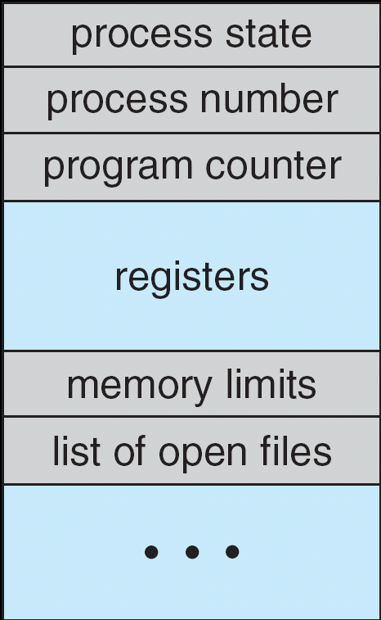
Process Control Block (PCB)

Slide 11
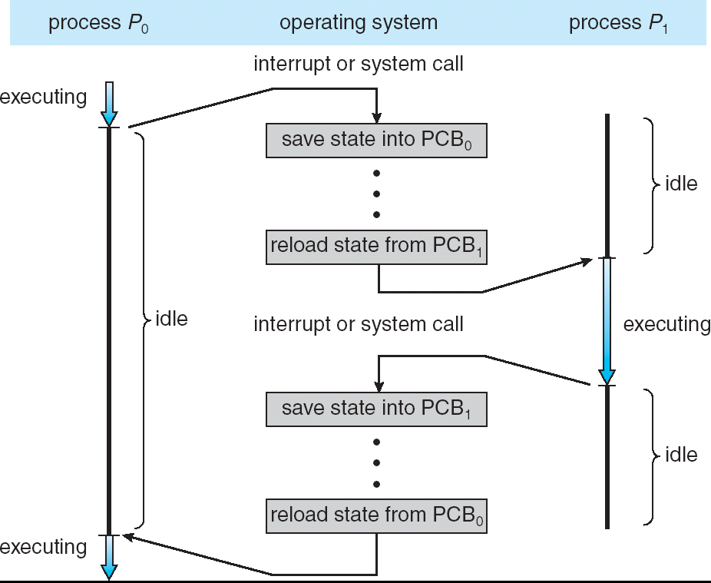
CPU Switch From Process to Process

Slide 12
Process Sceduling
Process Scheduling Queues
Job queue – set of all processes in the system
Ready queue – set of all processes residing in main memory, ready and waiting to execute
Device queues – set of processes waiting for an I/O device
Processes migrate among the various queues

Slide 13
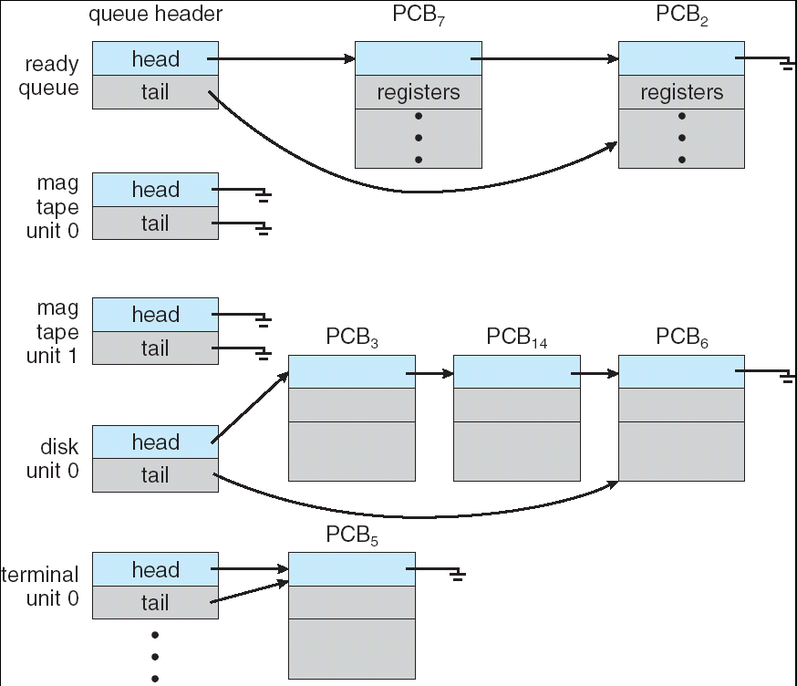
Ready Queue And Various I/O Device Queues

Slide 14
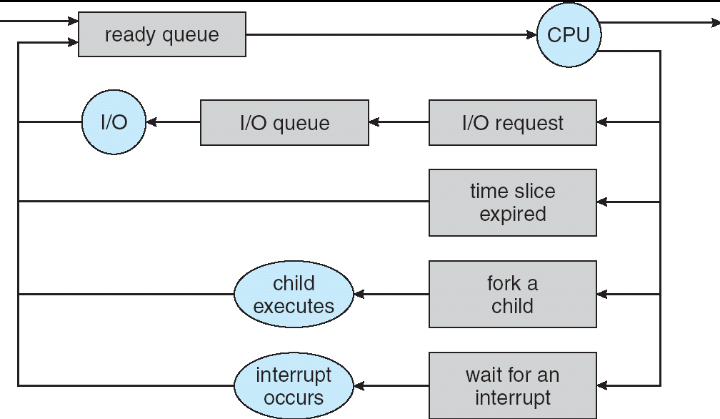
Representation of Process Scheduling

Slide 15
Schedulers
Long-term scheduler (or job scheduler) – selects which processes should be brought into the ready queue
Short-term scheduler (or CPU scheduler) – selects which process should be executed next and allocates CPU
Medium-term scheduler

Slide 16
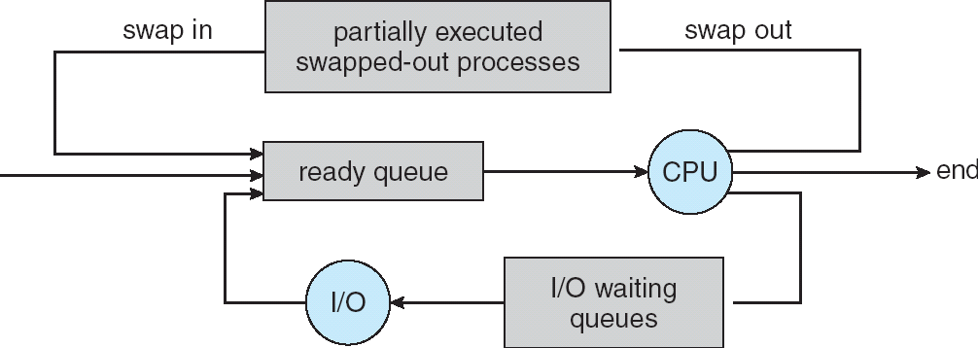
Addition of Medium Term Scheduling

Slide 17
Schedulers (Cont.)
Short-term scheduler is invoked very frequently (milliseconds) ⇒ (must be fast)
Long-term scheduler is invoked very infrequently (seconds, minutes) ⇒ (may be slow)
The long-term scheduler controls the degree of multiprogramming
Processes can be described as either:
I/O-bound process – spends more time doing I/O than computations, many short CPU bursts
CPU-bound process – spends more time doing computations; few very long CPU bursts

Slide 18
Context Switch
When CPU switches to another process, the system must save the state of the old process and load the saved state for the new process
Context-switch time is overhead; the system does no useful work while switching
Threads reduces overhead of process switch
Lightweight process with a reduced state

Slide 19
Operations on Processes
Process Creation
Parent process create children processes, which, in turn create other processes, forming a tree of processes
Resource sharing
Parent and children share all resources
Children share subset of parent’s resources
Parent and child share no resources
Execution
Parent and children execute concurrently
Parent waits until children terminate

Slide 20
Process Creation (Cont.)
Address space
Child duplicate of parent
Child has a program loaded into it
UNIX examples
fork system call creates new process
exec system call used after a fork to replace the process’ memory space with a new program

Slide 21
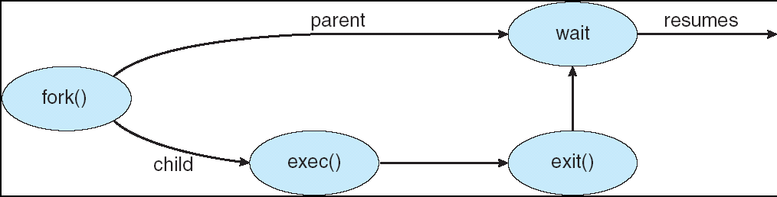
Process Creation

Slide 22
Process Termination
Process executes last statement and asks the operating system to delete it (exit)
Output data from child to parent (via wait)
Process’ resources are deallocated by operating system
Parent may terminate execution of children processes (abort)
Child has exceeded allocated resources
Task assigned to child is no longer required
If parent is exiting
Some operating system do not allow child to continue if its parent terminates
All children terminated - cascading termination

Slide 23
Operating System Services
Create(pid,attr)
Delete(pid)
Abort(pid)
Fork/Join
Suspend(pid)
Resume(pid)
Delay(pid,time)
Get_Attributes(pid,attrset)
Change_Priority(pid, new priority)

Slide 24
CPU Scheduling

Slide 25
Basic Concepts
Maximum CPU utilization obtained with multiprogramming
CPU–I/O Burst Cycle – Process execution consists of a cycle of CPU execution and I/O wait
CPU burst distributionFor I/O bound process: very short CPU bursts
For CPU bound process: few very long CPU bursts

Slide 26
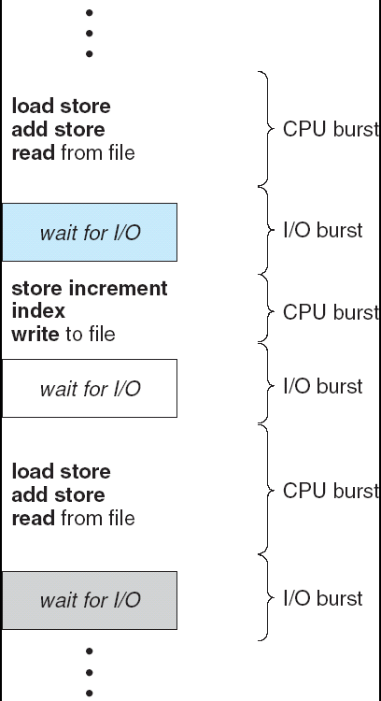
Alternating Sequence of CPU And I/O Bursts

Slide 27
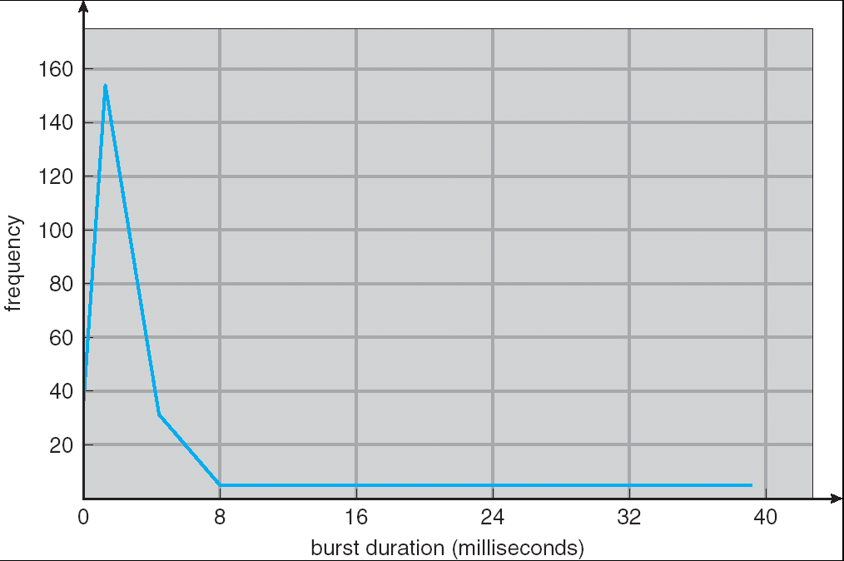
Histogram of CPU-burst Times

Slide 28
CPU Scheduler
Selects from among the processes in memory that are ready to execute, and allocates the CPU to one of them
CPU scheduling decisions may take place when a process:
1. Switches from running to waiting state
2. Switches from running to ready state
3. Switches from waiting to ready
4. Terminates
Scheduling under 1 and 4 is nonpreemptive
All other scheduling is preemptive

Slide 29
Dispatcher
Dispatcher module gives control of the CPU to the process selected by the short-term scheduler; this involves:
switching context
switching to user mode
jumping to the proper location in the user program to restart that program
Dispatch latency – time it takes for the dispatcher to stop one process and start another running

Slide 30
Scheduling Criteria
CPU utilization – keep the CPU as busy as possible
Throughput – # of processes that complete their execution per time unit
Turnaround time – amount of time to execute a particular process
Waiting time – amount of time a process has been waiting in the ready queue
Response time – amount of time it takes from when a request was submitted until the first response is produced, not output (for time-sharing environment)

Slide 31
Optimization Criteria
Max CPU utilization
Max throughput
Min turnaround time
Min waiting time
Min response time

Slide 32
Scheduling Algorithms

Slide 33
First Come First Serve (FCFS)
The process that requests the CPU is allocated the CPU first.
Easy implementation
Using FIFO Queue

Slide 34
First-Come, First-Served (FCFS) Scheduling
Process Burst Time
P₁ 24
P₂ 3
P₃ 3
Suppose that the processes arrive in the order: P₁ , P₂ , P₃ The Gantt Chart for the schedule is:
Waiting time for P₁ = 0; P₂ = 24; P₃ = 27
Average waiting time: (0 + 24 + 27)/3 = 17
P₁
P₂
P₃
0
24
27
30

Slide 35
FCFS Scheduling (Cont.)
Suppose that the processes arrive in the order
P₂ , P₃ , P₁
The Gantt chart for the schedule is:
Waiting time for P₁ = 6; P₂ = 0; P₃ = 3
Average waiting time: (6 + 0 + 3)/3 = 3
Much better than previous case
Convoy effect short process behind long process
P₂
P₃
P₁
0
3
6
30

Slide 36
Shortest-Job-First (SJR) Scheduling
Associate with each process the length of its next CPU burst. Use these lengths to schedule the process with the shortest time
Two schemes:
nonpreemptive – once CPU given to the process it cannot be preempted until completes its CPU burst
preemptive – if a new process arrives with CPU burst length less than remaining time of current executing process, preempt. This scheme is know as the Shortest-Remaining-Time-First (SRTF)
SJF is optimal – gives minimum average waiting time for a given set of processes

Slide 37
Example of Non-Preemptive SJF
Process Arrival Time Burst Time
P₁ 0.0 7
P₂ 2.0 4
P₃ 4.0 1
P₄ 5.0 4
SJF (non-preemptive)
Average waiting time = (0 + 6 + 3 + 7)/4 = 4
P₁
P₃
P₂
P₄
0
3
7
8
12
16

Slide 38
Example of Preemptive SJF
Process Arrival Time Burst Time
P₁ 0.0 7
P₂ 2.0 4
P₃ 4.0 1
P₄ 5.0 4
SJF (preemptive)
Average waiting time = (9 + 1 + 0 +2)/4 = 3
P₁
P₂
P₃
P₂
P₄
P₁
0
2
4
5
7
11
16

Slide 39
Priority Scheduling
A priority number (integer) is associated with each process
The CPU is allocated to the process with the highest priority (smallest integer ≡ highest priority)
Preemptive
nonpreemptive
SJF is a priority scheduling where priority is the predicted next CPU burst time
Problem ≡ Starvation – low priority processes may never execute
Solution ≡ Aging – as time progresses increase the priority of the process

Slide 40
Round Robin (RR)
Each process gets a small unit of CPU time (time quantum), usually 10-100 milliseconds. After this time has elapsed, the process is preempted and added to the end of the ready queue.
If there are n processes in the ready queue and the time quantum is q, then each process gets 1/n of the CPU time in chunks of at most q time units at once. No process waits more than (n-1)q time units.
Performance
q large ⇒ FIFO
q small ⇒ q must be large with respect to context switch, otherwise overhead is too high

Slide 41
Example of RR with Time Quantum = 20
Process Burst Time
P₁ 53
P₂ 17
P₃ 68
P₄ 24
The Gantt chart is:
P₁
P₂
P₃
P₄
P₁
P₃
P₄
P₁
P₃
P₃
0
20
37
57
77
97
117
121
134
154
162

Slide 42
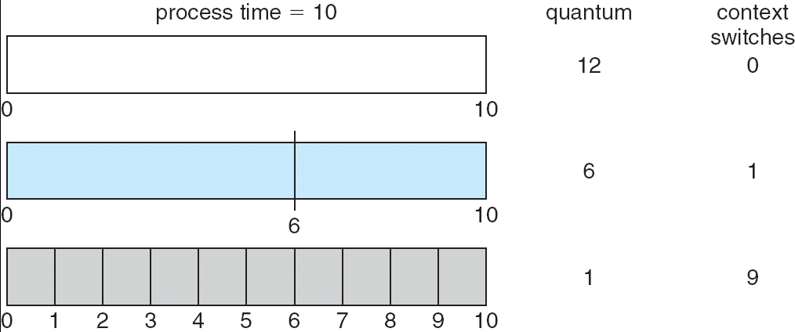
Time Quantum and Context Switch Time

Slide 43
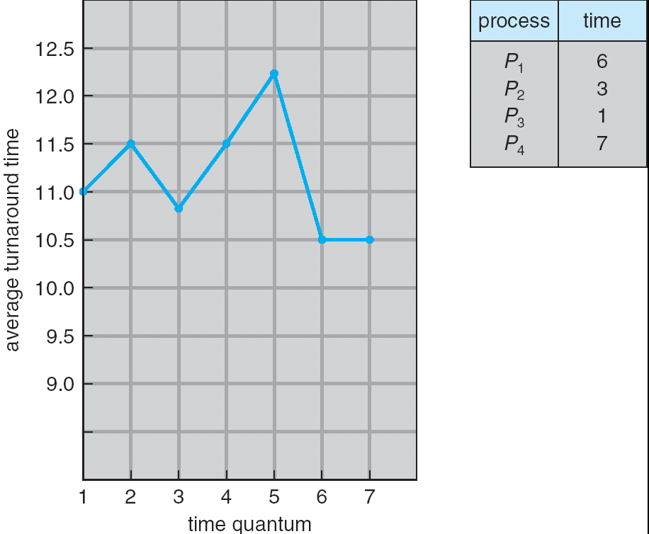
Turnaround Time Varies With The Time Quantum

Slide 44
Multilevel Queue
Ready queue is partitioned into separate queues: foreground (interactive) background (batch)
Each queue has its own scheduling algorithm
foreground – RR
background – FCFS
Scheduling must be done between the queues
Fixed priority scheduling; (i.e., serve all from foreground then from background). Possibility of starvation.
Time slice – each queue gets a certain amount of CPU time which it can schedule amongst its processes; i.e., 80% to foreground in RR
20% to background in FCFS

Slide 45
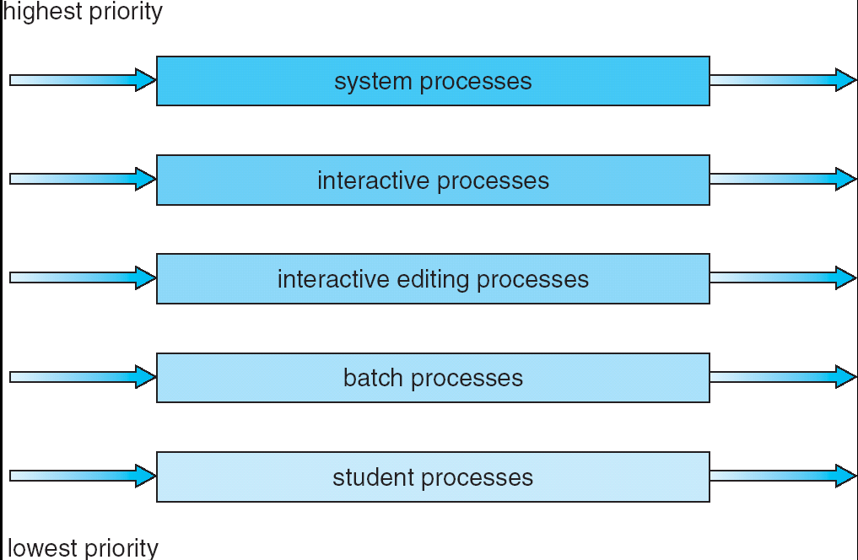
Multilevel Queue Scheduling

Slide 46
Multilevel Feedback Queue
A process can move between the various queues; aging can be implemented this way
Multilevel-feedback-queue scheduler defined by the following parameters:
number of queues
scheduling algorithms for each queue
method used to determine when to upgrade a process
method used to determine when to demote a process
method used to determine which queue a process will enter when that process needs service

Slide 47
Example of Multilevel Feedback Queue
Three queues:
Q₀ – RR with time quantum 8 milliseconds
Q₁ – RR time quantum 16 milliseconds
Q₂ – FCFS
Scheduling
A new job enters queue Q₀ which is served FCFS. When it gains CPU, job receives 8 milliseconds. If it does not finish in 8 milliseconds, job is moved to queue Q₁.
At Q₁ job is again served FCFS and receives 16 additional milliseconds. If it still does not complete, it is preempted and moved to queue Q₂.

Slide 48
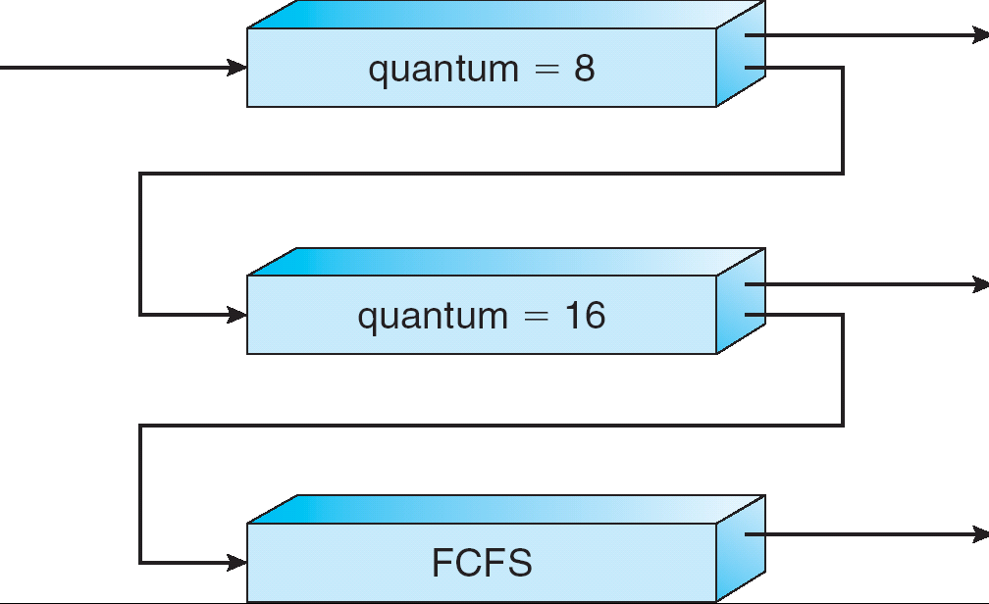
Multilevel Feedback Queues

Slide 49
Multiple-Processor Scheduling
CPU scheduling more complex when multiple CPUs are available
Homogeneous processors within a multiprocessor
Load sharing
Self scheduling
Master/slave scheduling
Asymmetric multiprocessing – only one processor accesses the system data structures, alleviating the need for data sharing

Slide 50
Real-Time Scheduling
Hard real-time systems – required to complete a critical task within a guaranteed amount of time
Resource reservation
Soft real-time computing – requires that critical processes receive priority over less fortunate ones
Aging not allowed
Dispatch latency small
Preemption points-at safe locations
Priority inversion—priority inheritance protocol

Slide 51
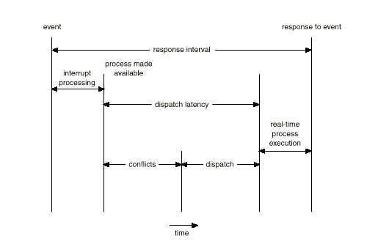
Dispatch Latency

Slide 52
Algorithm Evaluation
Define selection criteria
Evaluate algorithms
Deterministic modeling – takes a particular predetermined workload and defines the performance of each algorithm for that workload
Queueing models
Queueing network analysis
Little’s formula
Simulation
Implementation

Slide 53
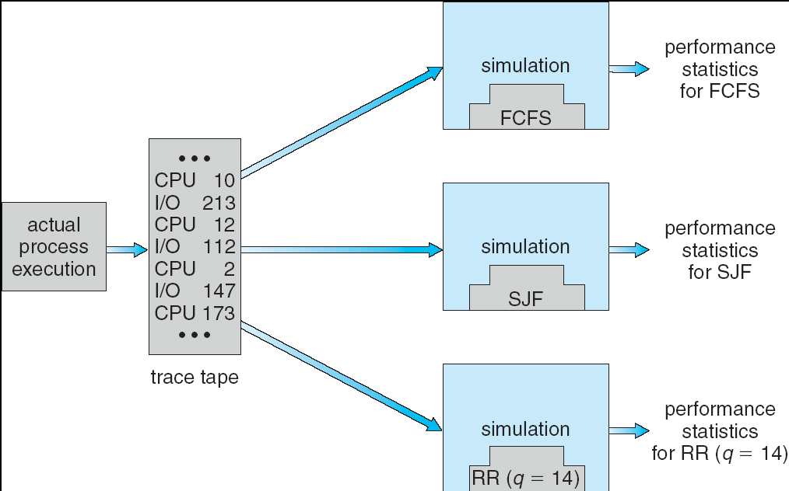

Slide 54
Cooperating Processes
Independent process cannot affect or be affected by the execution of another process
Cooperating process can affect or be affected by the execution of another process
Advantages of process cooperation
Information sharing
Computation speed-up
Modularity
Convenience

Slide 55
Producer-Consumer Problem
Paradigm for cooperating processes, producer process produces information that is consumed by a consumer process
Example: a print program produces characters that are consumed by printer driver
To run concurrently
unbounded-buffer places no practical limit on the size of the buffer
bounded-buffer assumes that there is a fixed buffer size

Slide 56
Bounded-Buffer – Shared-Memory Solution
Shared data
#define BUFFER_SIZE 10
Typedef struct {
. . .
} item;
item buffer[BUFFER_SIZE];
int in = 0;
int out = 0;
Solution is correct, but can only use BUFFER_SIZE-1 elements

Slide 57
Bounded-Buffer – Producer Process
item nextProduced;
while (1) {
while (((in + 1) % BUFFER_SIZE) == out)
; /* do nothing */
buffer[in] = nextProduced;
in = (in + 1) % BUFFER_SIZE;
}

Slide 58
Bounded-Buffer – Consumer Process
item nextConsumed;
while (1) {
while (in == out)
; /* do nothing */
nextConsumed = buffer[out];
out = (out + 1) % BUFFER_SIZE;
}

Slide 59
Interprocess Communication (IPC)
Mechanism for processes to communicate and to synchronize their actions
Message system – processes communicate with each other without resorting to shared variables
IPC facility provides two operations:
send(message) – message size fixed or variable
receive(message)
If P and Q wish to communicate, they need to:
establish a communication link between them
exchange messages via send/receive
Implementation of communication link
physical (e.g., shared memory, hardware bus)
logical (e.g., logical properties)

Slide 60
Direct Communication
Processes must name each other explicitly:
send (P, message) – send a message to process P
receive(Q, message) – receive a message from process Q
Properties of communication link
Links are established automatically
A link is associated with exactly one pair of communicating processes
Between each pair there exists exactly one link
The link may be unidirectional, but is usually bi-directional

Slide 61
Indirect Communication
Messages are directed and received from mailboxes (also referred to as ports)
Each mailbox has a unique id
Processes can communicate only if they share a mailbox
Properties of communication link
Link established only if processes share a common mailbox
A link may be associated with many processes
Each pair of processes may share several communication links
Link may be unidirectional or bi-directional

Slide 62
Indirect Communication
Operations
create a new mailbox
send and receive messages through mailbox
destroy a mailbox
Primitives are defined as:
send(A, message) – send a message to mailbox A
receive(A, message) – receive a message from mailbox A

Slide 63
Indirect Communication
Mailbox sharing
P₁, P₂, and P₃ share mailbox A
P₁, sends; P₂ and P₃ receive
Who gets the message?
Solutions
Allow a link to be associated with at most two processes
Allow only one process at a time to execute a receive operation
Allow the system to select arbitrarily the receiver. Sender is notified who the receiver was.

Slide 64
Synchronization
Message passing may be either blocking or non-blocking
Blocking is considered synchronous
Blocking send has the sender block until the message is received
Blocking receive has the receiver block until a message is available
Non-blocking is considered asynchronous
Non-blocking send has the sender send the message and continue
Non-blocking receive has the receiver receive a valid message or null

Slide 65
Buffering
Queue of messages attached to the link; implemented in one of three ways
1. Zero capacity – 0 messages Sender must wait for receiver
2. Bounded capacity – finite length of n messages Sender must wait if link full
3. Unbounded capacity – infinite length Sender never waits

Slide 66
Client-Server Communication
Sockets
Remote Procedure Calls
Remote Method Invocation (Java)

Slide 67
Sockets
A socket is defined as an endpoint for communication
Concatenation of IP address and port
The socket 161.25.19.8:1625 refers to port 1625 on host 161.25.19.8
Communication consists between a pair of sockets

Slide 68
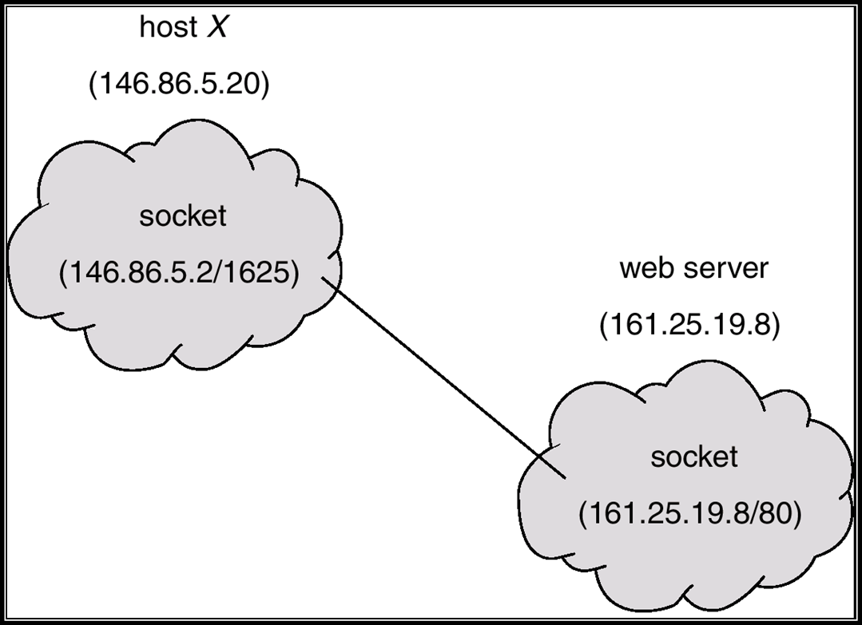
Socket Communication

Slide 69
Remote Procedure Calls
Remote procedure call (RPC) abstracts procedure calls between processes on networked systems.
Stubs – client-side proxy for the actual procedure on the server.
The client-side stub locates the server and marshalls the parameters.
The server-side stub receives this message, unpacks the marshalled parameters, and peforms the procedure on the server.

Slide 70
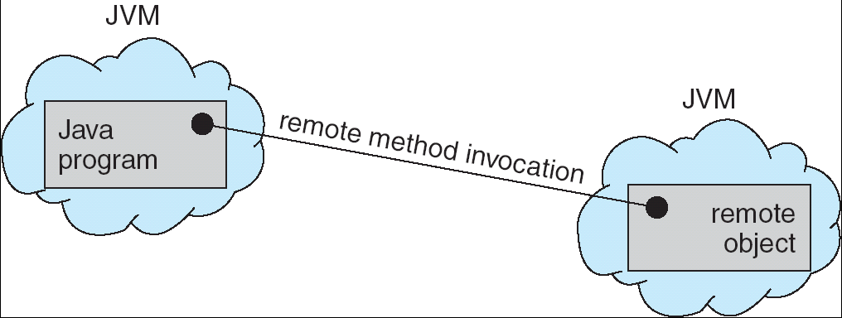
Remote Method Invocation
Remote Method Invocation (RMI) is a Java mechanism similar to RPCs.
RMI allows a Java program on one machine to invoke a method on a remote object.

Slide 71
Process Synchronization

Slide 72
Background
Concurrent access to shared data may result in data inconsistency
Maintaining data consistency requires mechanisms to ensure the orderly execution of cooperating processes
Suppose that we wanted to provide a solution to the consumer-producer problem that fills all the buffers. We can do so by having an integer count that keeps track of the number of full buffers. Initially, count is set to 0. It is incremented by the producer after it produces a new buffer and is decremented by the consumer after it consumes a buffer.

Slide 73
Producer
while (true)
/* produce an item and put in nextProduced
while (count == BUFFER_SIZE)
; // do nothing
buffer [in] = nextProduced;
in = (in + 1) % BUFFER_SIZE;
count++;
}

Slide 74
Consumer
while (1)
{
while (count == 0)
; // do nothing
nextConsumed = buffer[out];
out = (out + 1) % BUFFER_SIZE;
count--;
/* consume the item in nextConsumed
}

Slide 75
Bounded Buffer
The statements counter++; counter--; must be performed atomically.
Atomic operation means an operation that completes in its entirety without interruption.

Slide 76
Race Condition
count++ could be implemented as register1 = count register1 = register1 + 1 count = register1
count-- could be implemented as register2 = count register2 = register2 - 1 count = register2

Slide 77
Consider this execution interleaving with “count = 5” initially:
S0: producer execute register1 = count {register1 = 5} S1: producer execute register1 = register1 + 1 {register1 = 6} S2: consumer execute register2 = count {register2 = 5} S3: consumer execute register2 = register2 - 1 {register2 = 4} S4: producer execute count = register1 {count = 6 } S5: consumer execute count = register2 {count = 4}
The value of count may be either 4 or 6, where the correct result should be 5.

Slide 78
Critical section
Each process has a segment of code called a critical section, in which the process may change common variables, updating a table, writing a file and so on.
Entry section
Exit section
Remainder section
do
{
Critical section
Remainder section
}
while (1);
entry section
Exit section

Slide 79
Solution to Critical-Section Problem
1. Mutual Exclusion - If process P_{i} is executing in its critical section, then no other processes can be executing in their critical sections
2. Progress - If no process is executing in its critical section and there exist some processes that wish to enter their critical section, then the selection of the processes that will enter the critical section next cannot be postponed indefinitely
3. Bounded Waiting - A bound must exist on the number of times that other processes are allowed to enter their critical sections after a process has made a request to enter its critical section and before that request is granted
Assume that each process executes at a nonzero speed
No assumption concerning relative speed of the N processes

Slide 80
Two Process Solution-Algoritm-1
Two processes are numbered P0 and P1. i.e, Pi and Pj
Algorithm 1
A common integer variable turn initialized to 0 or 1. If turn==i Process Pi is allowed to execute in its critical section.
Disadvantage
does not retain the sufficient information about the state of each process.
For Process Pi
do {
while (turn!=i);
CRITICAL SECTION
turn=j;
REMAINDER SECTION
} while(1);

Slide 81
Algorithm-2
For Process pi
do {
flag[i]=true;
while(flag[j]);
CRITICAL SECTION
flag[i]=false;
REMAINDER SECTION
}while(1)
Disadvantage
mutual exclusion is preserved
progress requirement is not met
t0: P0 sets flag[0]=true
t1:P1 sets flag[1]=true
looping fore-ever

Slide 82
Algorithm-3-Peterson’s Solution
Two process solution
The two processes share two variables:
int turn;
Boolean flag[2]
The variable turn indicates whose turn it is to enter the critical section.
The flag array is used to indicate if a process is ready to enter the critical section. flag[i] = true implies that process P_{i} is ready!

Slide 83
Algorithm for Process P_{i}
do {
flag[i] = TRUE;
turn = j;
while ( flag[j] && turn == j);
CRITICAL SECTION
flag[i] = FALSE;
REMAINDER SECTION
} while (TRUE);

Slide 84
Multiple Process Solution
Bakery Algorithm
Data structures used
Boolean choosing[n];
int number[n]
- intialized to false and 0 respectively
Notations used
(a,b)<(c,d) ifa<c or a==c and b<d
Max(a₀,…a_{n-1)} is a number k,such that k>=a_{i} for i=0,…n-1

Slide 85
do
{
Choosing[i]=true;
Number[i]=max(number[0],number[1],…number[n-1])+1;
Choosing[i]=false;
for(j=0;j<n;j++) {
while(choosing[j]);
while(number[j]!=0)&&(number[j],j)<number[i],i));
}
CRITICAL SECTION
number[i]=0;
REMAINDER SECTIION
}while(1);

Slide 86
Synchronization Hardware
Many systems provide hardware support for critical section code
Uniprocessors – could disable interrupts
Currently running code would execute without preemption
Generally too inefficient on multiprocessor systems
Operating systems using this not broadly scalable
Modern machines provide special atomic hardware instructions
Atomic = non-interruptable
Either test memory word and set value
Or swap contents of two memory words

Slide 87
Synchronization Hardware
Either test memory word and set value
the test-and-set instruction is an instruction used to write to a memory location and return its old value as a single atomic (i.e., non-interruptible) operation.
If multiple processes may access the same memory, and if a process is currently performing a test-and-set, no other process may begin another test-and-set until the first process is done.
Or swap contents of two memory words
swap a special instruction that atomically compares the contents of a memory location to a given value and, if they are the same, modifies the contents of that memory location to a given new value. The result of the operation must indicate whether it performed the substitution

Slide 88
TestAndndSet Instruction
Definition:
boolean TestAndSet (boolean *target)
{
boolean rv = *target;
*target = TRUE;
return rv:
}

Slide 89
Solution using TestAndSet
Shared boolean variable lock., initialized to false.
Solution:
do {
while ( TestAndSet (&lock ))
; /* do nothing
// critical section
lock = FALSE;
// remainder section
} while ( TRUE);

Slide 90
Swap Instruction
Definition:
void Swap (boolean *a, boolean *b)
{
boolean temp = *a;
*a = *b;
*b = temp:
}

Slide 91
Solution using Swap
Shared Boolean variable lock initialized to FALSE; Each process has a local Boolean variable key.
Solution:
do {
key = TRUE;
while ( key == TRUE)
Swap (&lock, &key );
// critical section
lock = FALSE;
// remainder section
} while ( TRUE);

Slide 92
Bounded –waiting mutual exclusion with TestAndSet
do {
waiting[i]=true;
key = true
while (waiting[i])&&key)
key= TestAnd Set(lock);
waiting[i]=false;
}
Critical Section
J=(i+1)%n;
While((j!=i)&&!waiting[j])
J=(j+1)%n;
If(j==i)
Lock=false;
Else
Waiting[j]=false;
Remainder section
}(1)

Slide 93
Semaphore
A semaphore S is an integer variable that apart from initialization is accessed only through two standard atomic operations: wait and signal
Synchronization tool that does not require busy waiting
Semaphore S – integer variable
Two standard operations modify S: wait() and signal()
Originally called P() and V()
Less complicated
Can only be accessed via two indivisible (atomic) operations
wait (S) {
while S <= 0
; // no-op
S--;
}
signal (S) {
S++;
}

Slide 94
Usage
Semaphores can be used to deal with n-process critical section problem
n process share a semaphore, mutex initialized to 1
Provides mutual exclusion
Semaphore S; // initialized to 1
do {
wait (S);
Critical Section
signal (S);
Remainder section
} while(1);

Slide 95
Used to solve various concurrency problems.
Consider two concurrently running process
P1 with statement s1
P2 with statement s2
S2 should be executed only after s1 completes
Implementation
p1 and p2 share a common semaphore synch initialised to 0 and inserting
S1;
Signal(synch);
wait(synch);
s2;
in p1
in p2

Slide 96
Semaphore Implementation with no Busy waiting
Requires Busy waiting
While a process is in its critical section, any other process that tries to enter the critical section must loop continuously in the entry section.
This type of semaphore is called spinlocks.
Solution: modify the definition of wait() and signal() operations.
When a process executes wait operation and finds that semaphore value is not positive, it blocks itself; places the process into waiting queue and changes the status into waiting.
The process should be restarted by a wakeup operation

Slide 97
Implementation
With each semaphore there is an associated waiting queue. Each entry in a waiting queue has two data items:
value (of type integer)
pointer to next record in the list
Two operations:
block – place the process invoking the operation on the appropriate waiting queue.
wakeup – remove one of processes in the waiting queue and place it in the ready queue.

Slide 98

Semaphore Implementation with no Busy waiting (Cont.)
Implementation of wait:
wait (Semaphore S){
S.value--;
if (S.value < 0) {
add this process to waiting queue
block(); }
}
Implementation of signal:
Signal (Semaphore S){
S.value++;
if (S.value <= 0) {
remove a process P from the waiting queue
wakeup(P); }
}

Slide 99
Semaphore Implementation
Must guarantee that no two processes can execute wait () and signal () on the same semaphore at the same time
Thus, implementation becomes the critical section problem where the wait and signal code are placed in the crtical section.
Could now have busy waiting in critical section implementation
But implementation code is short
Little busy waiting if critical section rarely occupied
Note that applications may spend lots of time in critical sections and therefore this is not a good solution.

Slide 100
Semaphore as General Synchronization Tool
Counting semaphore – integer value can range over an unrestricted domain
Binary semaphore – integer value can range only between 0 and 1; can be simpler to implement
Also known as mutex locks
Can implement a counting semaphore S as a binary semaphore

Slide 101
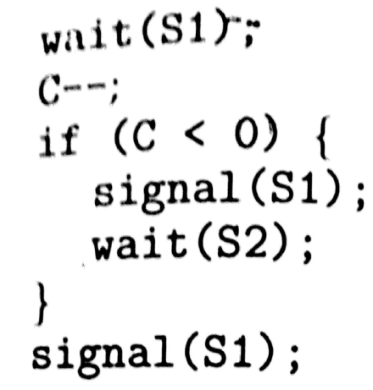
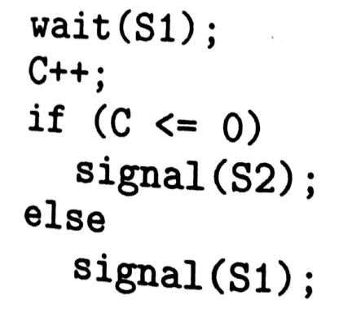
Binary Semaphore
Let S be a counting semaphoe
To implement it in binary semaphore
Binary-semaphore s1,s2;
Int c;
S1=1,s2=0
C=Value of S
Wait
Signal

Slide 102
Deadlock and Starvation
Deadlock – two or more processes are waiting indefinitely for an event that can be caused by only one of the waiting processes
Let S and Q be two semaphores initialized to 1
P₀ P₁
wait (S); wait (Q);
wait (Q); wait (S);
. .
. .
. .
signal (S); signal (Q);
signal (Q); signal (S);
Starvation – indefinite blocking. A process may never be removed from the semaphore queue in which it is suspended.

Slide 103
Classical Problems of Synchronization
Bounded-Buffer Problem
Readers and Writers Problem
Dining-Philosophers Problem

Slide 104
Bounded-Buffer Problem
N buffers, each can hold one item
Semaphore mutex initialized to the value 1
Semaphore full initialized to the value 0
Semaphore empty initialized to the value N.

Slide 105
Bounded Buffer Problem (Cont.)
The structure of the producer process
do {
// produce an item
wait (empty);
wait (mutex);
// add the item to the buffer
signal (mutex);
signal (full);
} while (true);

Slide 106
Bounded Buffer Problem (Cont.)
The structure of the consumer process
do {
wait (full);
wait (mutex);
// remove an item from buffer
signal (mutex);
signal (empty);
// consume the removed item
} while (true);

Slide 107
Readers-Writers Problem
A data set is shared among a number of concurrent processes
Readers – only read the data set; they do not perform any updates
Writers – can both read and write.
Problem – allow multiple readers to read at the same time. Only one single writer can access the shared data at the same time.
Shared Data
Data set
Semaphore mutex initialized to 1.
Semaphore wrt initialized to 1.
Integer readcount initialized to 0.

Slide 108
Readers-Writers Problem (Cont.)
The structure of a writer process
do {
wait (wrt) ;
// writing is performed
signal (wrt) ;
} while (true)

Slide 109
Readers-Writers Problem (Cont.)
The structure of a reader process
do {
wait (mutex) ;
readcount ++ ;
if (readercount == 1) wait (wrt) ;
signal (mutex)
// reading is performed
wait (mutex) ;
readcount - - ;
if readcount == 0) signal (wrt) ;
signal (mutex) ;
} while (true)

Slide 110
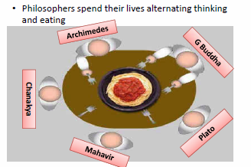
Dining-Philosophers Problem
Shared data
Bowl of rice (data set)
Semaphore chopstick [5] initialized to 1

Slide 111
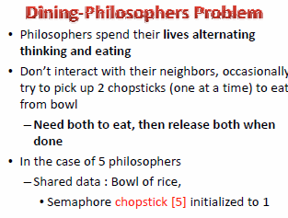

Slide 112
Dining-Philosophers Problem (Cont.)
The structure of Philosopher i:
Do {
wait ( chopstick[i] );
wait ( chopStick[ (i + 1) % 5] );
// eat
signal ( chopstick[i] );
signal (chopstick[ (i + 1) % 5] );
// think
} while (true) ;

Slide 113
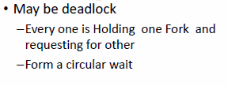
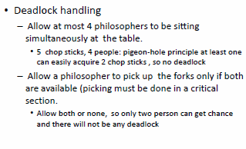
Problems & Solutions

Slide 114
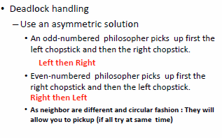

Slide 115
Problems with Semaphores
Incorrect use of semaphore operations:
signal (mutex) …. wait (mutex)
wait (mutex) … wait (mutex)
Omitting of wait (mutex) or signal (mutex) (or both)
Deadlocks / Starvation

Slide 116
Monitors
A high-level abstraction that provides a convenient and effective mechanism for process synchronization
Only one process may be active within the monitor at a time
monitor monitor-name
{
// shared variable declarations
procedure P1 (…) { …. }
…
procedure Pn (…) {……}
Initialization code ( ….) { … }
…
}
}

Slide 117
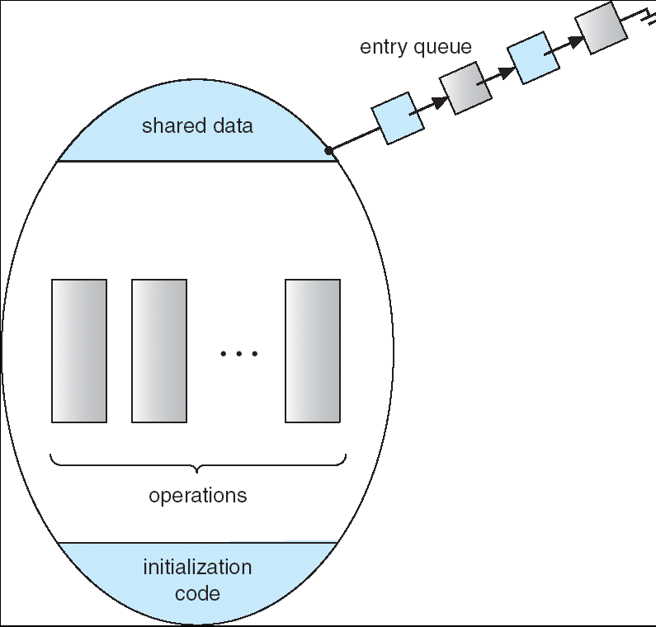
Schematic view of a Monitor

Slide 118
Condition Variables
condition x, y;
Two operations on a condition variable:
x.wait () – a process that invokes the operation is
suspended.
x.signal () – resumes one of processes (if any) tha
invoked x.wait ()

Slide 119
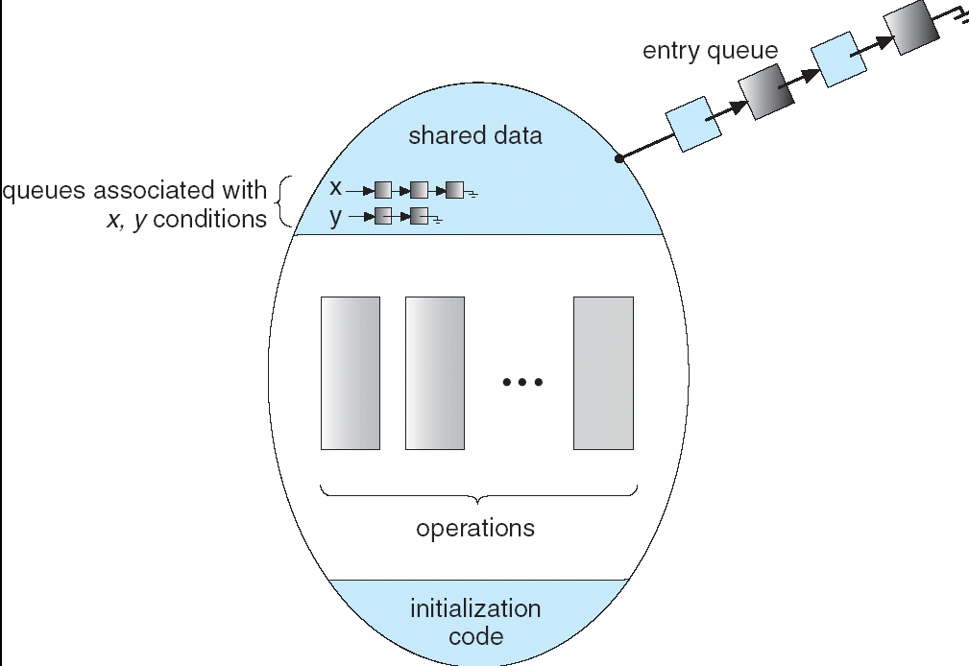
Monitor with Condition Variables

Slide 120
Solution to Dining Philosophers
monitor DP
{
enum { THINKING; HUNGRY, EATING) state [5] ;
condition self [5];
void pickup (int i) {
state[i] = HUNGRY;
test(i);
if (state[i] != EATING) self [i].wait;
}
void putdown (int i) {
state[i] = THINKING;
// test left and right neighbors
test((i + 4) % 5);
test((i + 1) % 5);
}

Slide 121
Solution to Dining Philosophers (cont)
void test (int i) {
if ( (state[(i + 4) % 5] != EATING) &&
(state[i] == HUNGRY) &&
(state[(i + 1) % 5] != EATING) ) {
state[i] = EATING ;
self[i].signal () ;
}
}
initialization_code() {
for (int i = 0; i < 5; i++)
state[i] = THINKING;
}
}

Slide 122
Solution to Dining Philosophers (cont)
Each philosopher i invokes the operations pickup()
and putdown() in the following sequence:
dp.pickup (i)
EAT
dp.putdown (i)

